Slide 1
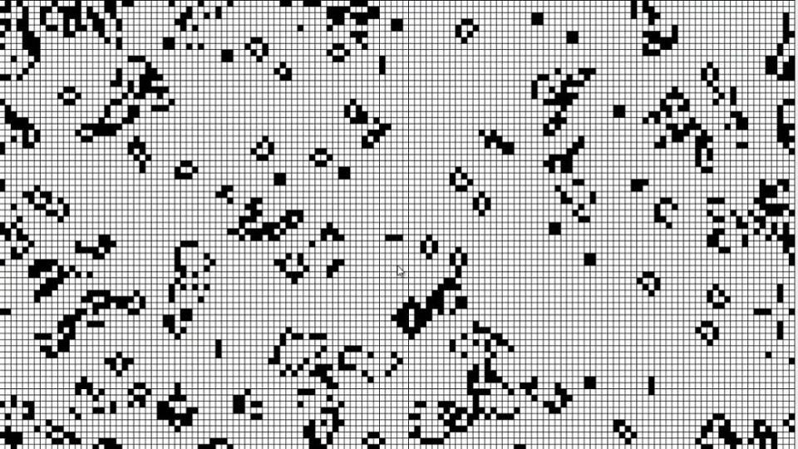
CELLULAR AUTOMATA
Way of modelling pixels on the screen that evolves through a number of discrete time steps according to a set of rules based on the state of neighboring cells
Forms complex patterns and animations from simple rules through iterations
Applications:
To model systems in Biology (To study the formation of colonies)
To model systems in physics (Brownian Movement)
To generate random numbers in Cryptography

Slide 2
Goal of our Project – GAME OF LIFE
To visualize Cellular Automata as described by John Horton Conway (also known as Conway's Game of Life) using OpenGL in C
Meant to show what happens to organisms when they're placed in closed proximity to each other.
Upon giving the game's initial condition, each successive iteration shows the evolution of organisms.

Slide 3
MOTIVATION
The Game of Life is not a typical computer game, but CELLULAR AUTOMATION.
Collection of cells which based on the environment can LIVE or DIE
Amazed by what a four simple rules can do, we got excited to simulate this project using OpenGL

Slide 4
LIMITATIONS OF EXISTING SYSTEM
Restricted to grid world, solely depends on initial conditions & 4 rules
All organisms are considered same, no difference like age!
So, it's not suitable when using this system to mimic population in real world
Also, the pixels are restricted to black (dead) & white (alive)

Slide 5
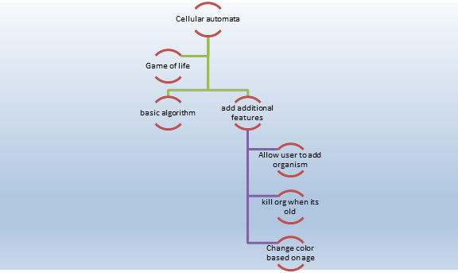
PROPOSED SYSTEM
Added cells that differ in age
Added new rules to the existing rules
Interactivity- Allow the user to add cells during evolution process

Slide 6
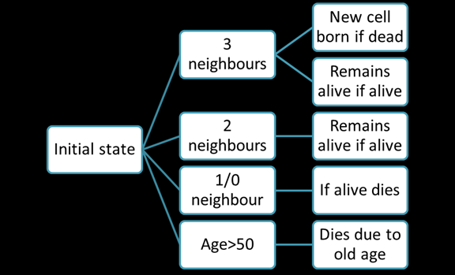
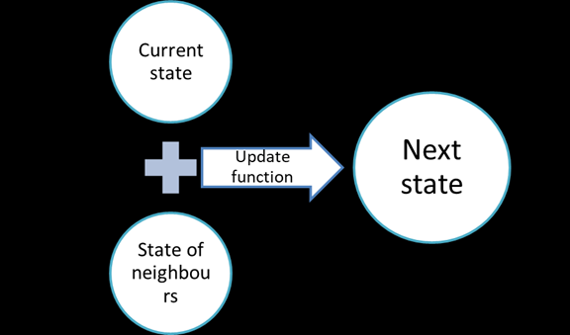
ALGORITHM
=3 | Remains alive if alive | Comes to Life if dead
=2 | Remains alive if alive
>3 | Over population -> Death
<2 (0/1) | Isolation -> Death
Age > 50 | Death due to old age

Slide 7
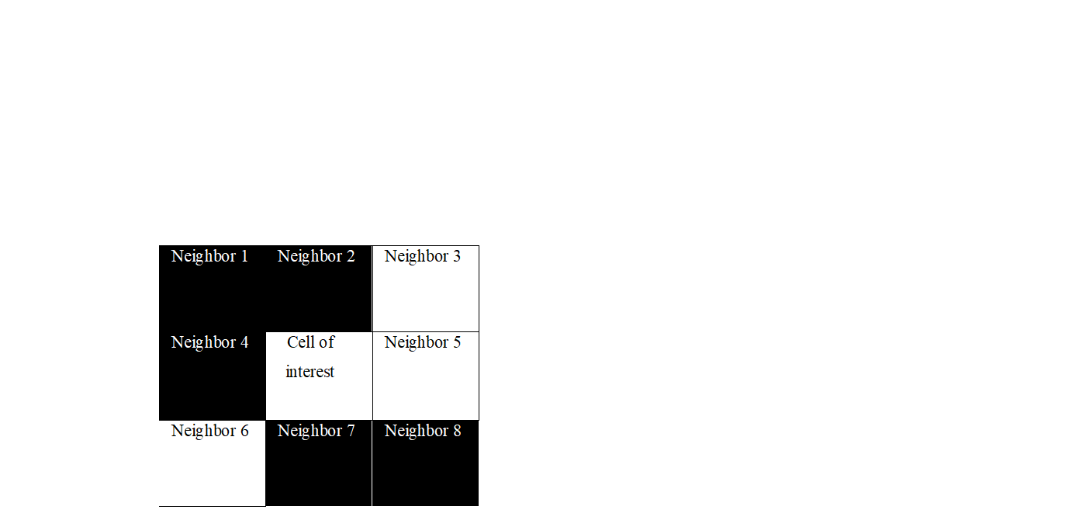
EXAMPLE
Black (Dead), White (Alive)
In this example, in the next iteration,
Neighbor 1 (D) remains dead (1)
Neighbor 2 (D) becomes alive (3)
Neighbor 3 (A) remains alive (2)
Neighbor 4 (D) remains alive (2)
(COI) remains alive (2)
Neighbor 5 (A) remains alive (2)
Neighbor 6 (A) dies of Isolation (<2)
Neighbor 7 (D) becomes alive (3)
Neighbor 8 (D) remains alive (2)

Slide 8
OVERVIEW OF FEATURES IMPLEMENTED IN OUR PROJECT
Initialize a Random State
Automatically run next iteration using Timer function
Concept of age that can be seen by the changing color (max age = 50, after which it dies)
Animation using Double Buffer mode
User Interactivity
KEYBOARD:
Press 2 to stop
Press 1 to play animation (Default Mode)
Press 3 to reset board to Blank state
MOUSE:
User can add organisms in the eco system by left click & drag in pause mode

Slide 9
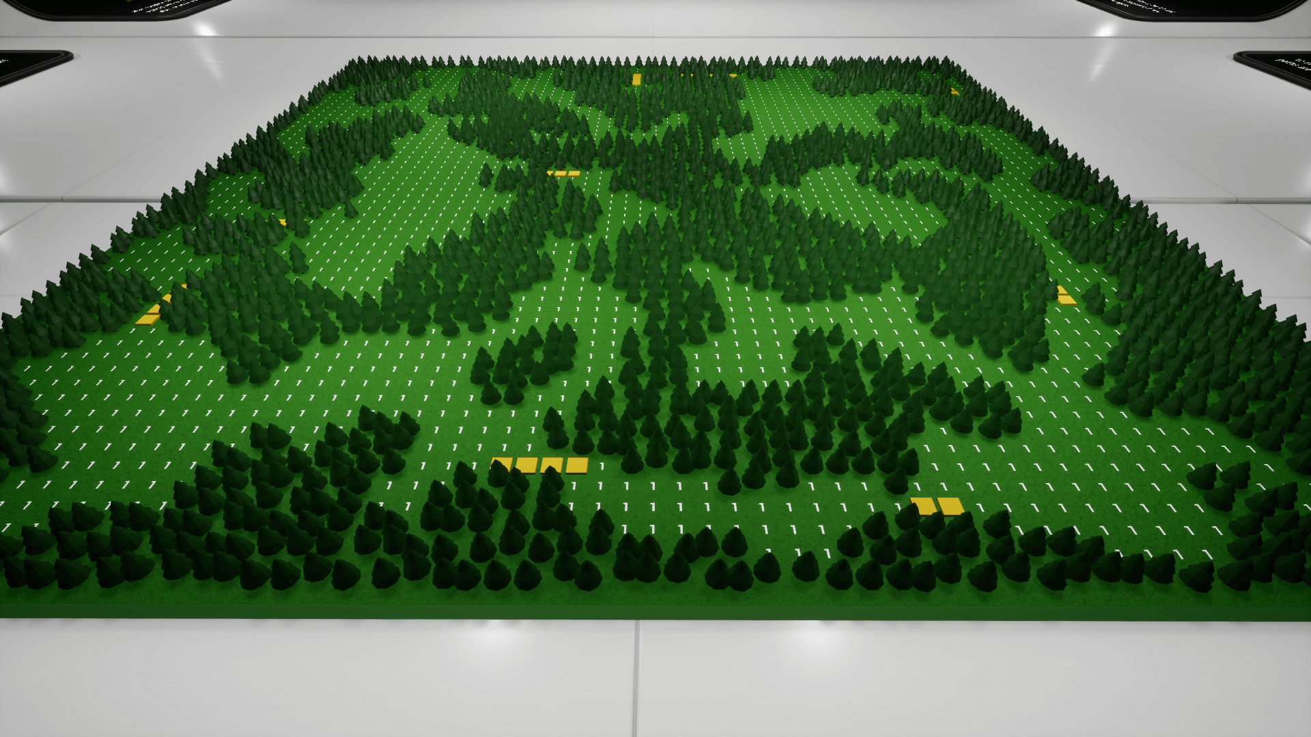
FUTURE ENHANCEMENTS
Feature to delete/ kill organisms
Extending this project to plants that mimic a real-world Ecosystem

Slide 10
THANK YOU!
- M AISHWARYA
- M MERLYN

